Slide 1


How to Purchase
Goods and Services
Purchases over $5,000

Slide 2
Goals
Understand the various types of purchasing options and how to categorize requests and apply them to the appropriate procurement method.
  Bidding Levels
  UW and Department of Administration Contracts
  Competitive Bidding and Sole Sourcing
  Catalog Searches in SUW+
  Answer questions from participants
  For additional information see How to Make a Purchase

Slide 3
Dollar Limits and Authorization:
Best Judgement:
Shop@UW+
Contracts
Preferred methods
$5000 or less
Must be:
On a Contract
Competitively Bid
Sole Sourced
Over $5000
All orders over $5,000 are approved by a Purchasing Agent

Slide 4
Competitive Purchases Over $5,000
>$5,000
<$50,000
Contract vendor
Simplified bid
>$50,000
Contract vendor
RFB-Request for Bid
RFP-Request for Proposal
Notes:
4

Slide 5
Sole Source Purchases Over $5,000
>$5,000
<$25,000
Approved Waivers
  Non-Competitive Purchase
  Request Form
>$25,000
Governor’s Waiver
Chapter 36 Waiver
Notes:
5

Slide 6
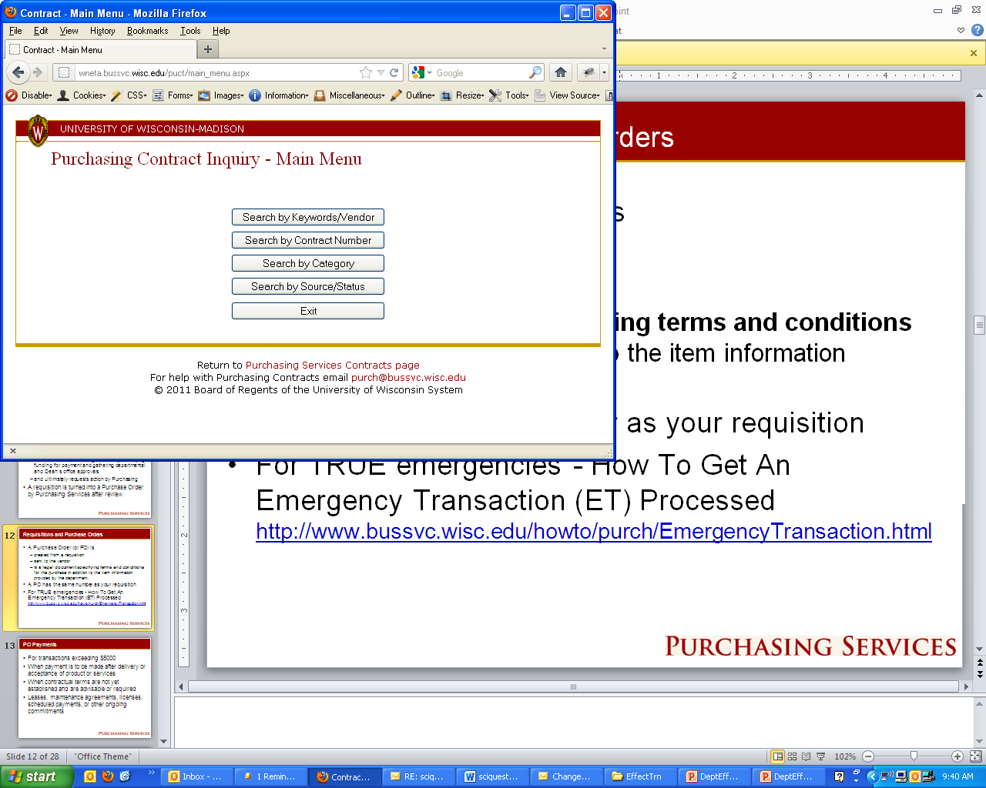
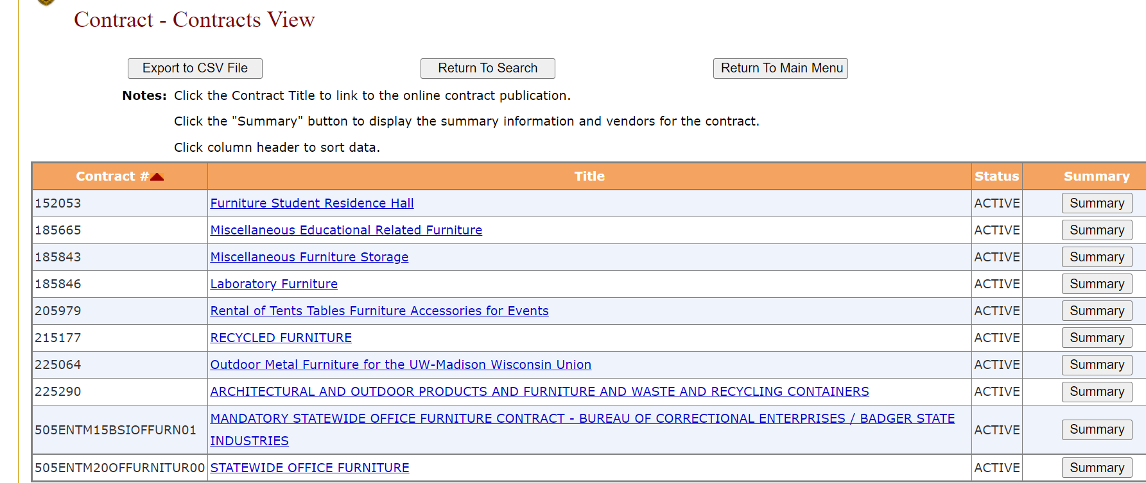
Contract Search Example Continued
Choose one of the search methods from the main menu
Keyword is usually best option
A listing of available contracts will populate

Slide 7
Simplified Bidding: Overview
Purchases over $5000 through $50,000
Consider other campus departments or other government agencies.
Simplified bidding should be initiated by departments. Contact Purchasing Services if assistance is needed.
Purchasing Services will
  Confirm the department’s recommendation for low bidder
  Seek a Supply Diversity provider quote
  Make the final award decision based on professional review
  Issue the purchase order and/or contract

Slide 8
Simplified Bids: The Process
Prepare written specs (written specs help ensure quotes are consistent):
  Quantity
  Product/manufacturer’s name
  Description
  Delivery deadline, location, installation requirements
  Freight costs (shipping & handling)
  Deadline for bids (a minimum of 3 business days)
  For additional information see:
  Simplified Bid Process
  Simplified Bid Policy # UW-3055

Slide 9
Simplified Bids: The Basics
Requires a minimum of 3 quotes from viable vendors
Minimum of 1 Supply Diversity Vendor (MBE, DVB)
Obtain quotes through: e-mail (preference), vendor websites, phone, or established price lists
Let vendors know you are taking bids for UW-Madison
Give a hard deadline to submit response
Must provide consistent information to all bidders
Complete Simplified Bid Summary Sheet and attach to the requisition with the vendors’ quotes.

Slide 10
Simplified Bidding: Process Requirements
Confidentiality of bids—No sharing of another vendor’s pricing, terms, etc.
Bid results—Cannot be released until Purchasing Services reviews the results and issues a PO
“No Response” and “No Bid”
When the department’s recommendation is to purchase from other than the low bidder, a justification explaining the deficiencies must be provided and approved by Purchasing Services.

Slide 11
Waivers and Sole Source
Purchasing Services is delegated to waive the competitive process up to $25,000 with appropriate justification.
Sole Sources over $25,000 require additional approval that can take up to 6-8 weeks.
Complete all sections of the Non-Competitive Purchase Request Form and submit with the requisition and vendor’s quote.
UW Madison and UW System pre-established waivers, e.g., equipment maintenance, research animals.

Slide 12
Processes Requiring Purchasing Agents
Requests for Bids (RFBs)
Requests for Proposals (RFPs)
Sole Source Waivers greater than $25,000

Slide 13
Academic Support Services Agreement (ASSAs)
Chapter 36 of Wisconsin Statutes
  Academic Support Services Agreements (ASSA)
    A UNIQUE service provider directly serving the University of Wisconsin’s mission of academic instruction and research.
    Not a grant Subagreement (Contact RSP for more information)
    Distinguished from other Sole Source waivers by nature of work to be performed.
See How to Buy a Service from a vendor not on contract.

Slide 14

Signatory Authority
Wis. Stats. 16.77(2) states whenever a person "...contracts for the purchase of supplies, materials, equipment or contractual services contrary to ss. 16.705 to 16.82 or rules promulgated ... the contract is void, and any officer or subordinate is liable for the cost thereof.
See Signature Authority Memo for who signs UW contracts.

Slide 15


Illegal Purchases
Intentionally avoiding the purchasing process:
  Serial purchasing
  Unauthorized purchases
  Getting ahead of the contracting process (beginning work without a signed agreement)

Slide 16
SHOPUW+ CATALOG SEARCH
Demonstration of Search in SUW+
At the Home Page select either Legacy View (all catalog vendors) or a specific category such as Lab Supplies.
In the Simple Search add the part number you are looking for. Manufacturer number is best if you have it.
Select the lowest cost item and add to the cart.

Slide 17
How to Purchase Goods and Services: Intermediate Topics
Feel Free to Contact us with Any Questions!
Purchasing Help Desk
262-1526
purch@bussvc.wisc.edu
Agent Directory
ShopUW+ Training Materials

Slide 18
Thank you for your participation.

